Slide 1
Enzymes Learning Objectives:
1-Describe enzyme nomenclature
2-Explain the Classification of enzymes
3-Study the mechanizem action of enzymes
4-illusterate factors affecting enzyme activity

Slide 2
Enzyme nomenclature
Two Systems:
1. By adding " ase " to the name of substrate .
Examples:- The enzyme catalyzes the hydrolysis of:
Urea is called Urease , Arginine is called arginase
2. IUB system : International Union of Biochemistry.
The enzyme name consists of 2 parts :
The 1st part: the name of substrate (s).
The 2nd part: the type of reaction ( ending in – ase )
Glutamate dehydrogenase
Aspartate aminotransferase
Sometimes common names are used, particularly for the digestion enzymes such as pepsin and trypsin

Slide 3
Clasification of enzymes
EC 1. Oxidoreductases
Catalyse Oxidation/Reduction Reactions. Act on many chemical groupings to add or remove electrons ,hydrogen and oxygen atoms.
Examples:Lactate dehydrogenase.Glucose Oxidase.
Peroxidase.Catalase.Phenylalanine hydroxylase.
.
Notes:
3

Slide 4
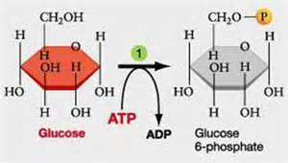
EC 2.Transferases
Transfer a functional groups (e.g. transaminase transfer of amino functional group (Alanine aminotransferase and Aspartate aminotransferase)
Kinases: transfer PO3 group from ATP to substrate, e.g., Hexokinase:
Notes:
4

Slide 5
EC 3. Hydrolases
Include enzymes catalyses the hydrolysis of bonds in the presences of water like ester , peptide, glycosidic bonds.
Ex: acid phosphatase, Alkaline phosphatase and Urease .
Notes:
5

Slide 6
Lyases EC 4.
Include enzymes catalyses removal of group from substrate by mechanism other than hydrolysis leaving double bond.
Ex: Aldolase
Fumarase
Decarboxylase
Notes:
6

Slide 7
EC 5 Isomerases.
Catalyse isomerization changes within a single molecule (interconversion).
Mutase reactions (Shifts of chemical groups).
Notes:
7
Isomerases are a general class of enzymes which convert a molecule from one isomer to another.. The general form of such a reaction is as follows:
A–B → B–A

Slide 8
EC 6. Ligases
Include enzymes catalyses the linking together of 2 compounds coupled with the breaking of apyrophosphate bond in ATP or a similar compound.
Ex: Glutamine synthetase(link 2molecules via an ATP-dependent reaction)
Carboxylase: add CO2 to substrate.
Notes:
8

Slide 9
Enzyme classes requires coenzymes :
Classes : 1 , 2 , 5 , 6.
Enzyme classes does not require coenzymes:
Classes: 3 , 4.
Substrate (reactant):
Is the substance on which the enzyme act converting it into product.
Active site:
Is the area in the enzyme structure involved in its catalytic activity . It is the site that bind to the substrate.

Slide 10
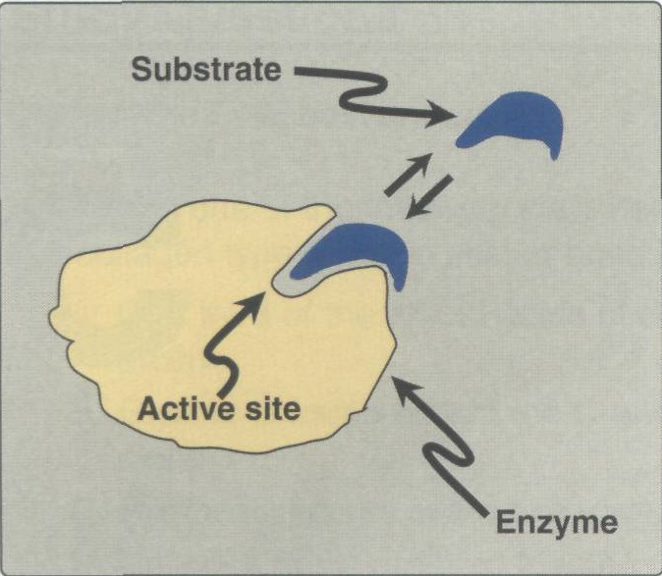

Slide 11
characterized of the active site :
1-Enzyme active sites are pockets in the surface of enzyme.
2- The shape of the active site is complementary to the shape of the substrate
3-The conformation of the active site determines the specifity of the enzyme because only the substrate that fits into the active site will be used in the a reaction.
4. It is a three dimensional entity.

Slide 12
Mechanisms of enzyme action Two theories: 1. Lock and Key theory: 2. Induced – fit theory:

Slide 13
Lock-and-Key Model
The substrate must have a matching shape to fit into the active site of the enzyme .The enzyme
can be visualized as containing grooves with fixed dimensions that permit only compounds with specific shape to be inserted in .
Lock and key theory implies rigidity of the active site .

Slide 14
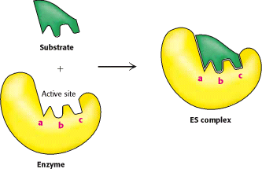
1. Lock and Key theory:

Slide 15
Induced Fit Model
The enzyme allow an initial superficial attachment of the substrate. This causes conformational changes that provide a more perfect apposition between the active site of the enzyme and the substrate. So, the shape of the active site is modified by substrate binding , and the active site has a shape which is complementary to that of the substrate only after the substrate is bound. Induced – fit theory implies flexibility of the active site.

Slide 16
Induced – fit theory:

Slide 17
Measurement of enzyme activity
Two units:
Katal ( Kat) : the amount of enzyme catalyses the conversion of 1 mole of substrate into product per second under optimal assay conditions.
International unit ( IU) : The amount of enzyme catalyses the conversion of 1 micromole of substrate into product per minute under optimal assay conditions.

Slide 18
Enzyme assay
Quantitative measurement of enzyme in a biological specimen ( enzyme assay ) is based on its catalytic activity.
Enzymes are assayed by either :
1. By measuring the rate of substrate disappearance. Ex: amylase
Or
2.By measuring the rate of product appearance.
Ex: Alkaline phosphatase.

Slide 19
Factors affecting enzyme activity
1.Substrate concentration:
At low substrate conc. Initial velocity V° is nearly proportional to substrate conc. The reaction is first order.
As substrate conc. Is increased the initial rate increase until it reach a max value V max .when further
increase in substrate conc. do not increase V the enzyme is saturated with substrate.
All the enzymes is present as ES complex since no free enzyme remain available for forming ES ,further increase in (S) cannot increase the rate of reaction (zero order )

Slide 20
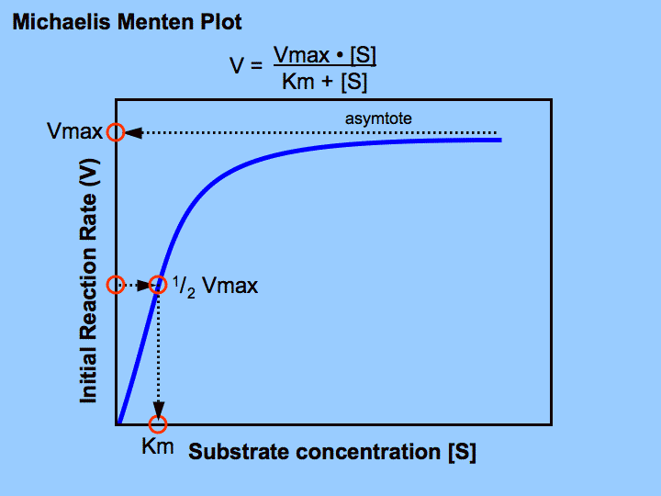

Slide 21
Michaelis – Menten Equation :
“It is an equation which describes how
reaction velocity varies with substrate concentration.”
Vo = Vmax (S)
Km + (S)
Where:
Vo : initial reaction
Vmax : maximal velocity
Km : Michaelis constant; is the substrate concentration at which the reaction rate is half maximal velocity.

Slide 22
Half of the enzyme molecules are saturated with the substrate, velocity is half maximal velocity (Vmax /2) .
at this enzyme concentration. The substrate concentration required to produce half maximal velocity of the enzyme catalyzed reaction is termed
Michaelis constant “Km ”.
Km=(S)

Slide 23
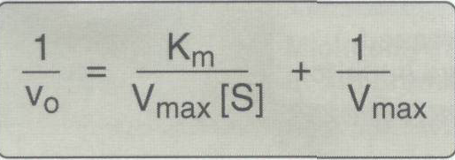
Lineweaver-Burk Plot
Represents a linear form of Michaelis-Menten equation.
Advantages of Lineweaver - Burk plot:- 1. Allow accurate determination of Vmax & Km. 2. Give valuable information on enzyme inhibition.

Slide 24
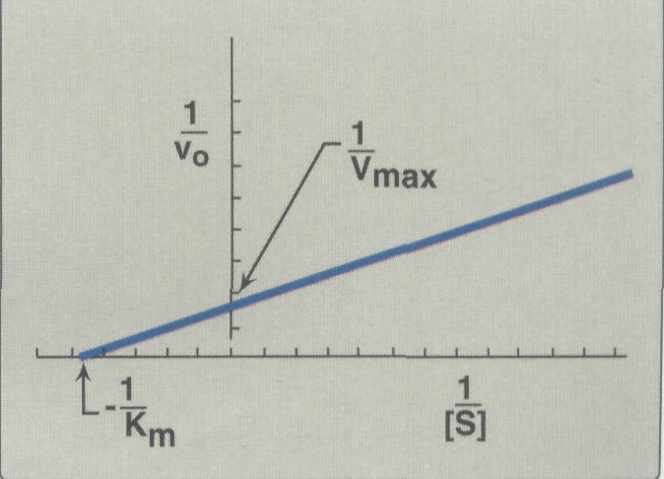
Lineweaver – Burk plot

Slide 25
2-Enzyme concentration
1-At low enzyme concentration there is great
competition for the active sites and the rate of reaction is low.
2-As the enzyme concentration increases, there are
more active sites and the reaction can proceed at a faster rate.
Eventually, increasing the enzyme concentration
beyond a certain point has no effect because the
substrate concentration becomes the limiting
factor.

Slide 26
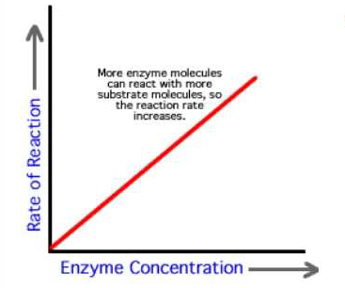
2. Enzyme concentration:
Reaction velocity is directly proportional to
concentration of enzyme
.

Slide 27
3. Temperature
Raising the temperature increases the rate of both
Un catalyzed and enzyme-catalyzed reactions by increasing
the kinetic energy and the collision frequency of the
reacting molecules.
↓ of velocity with higher T
However, heat energy can also increase the kinetic energy
of the enzyme to a point that exceeds the energy barrier for
disrupting the non covalent interactions that maintain its
three dimensional structure.

Slide 28
The Q10, or temperature coefficient, is the factor by which rate of a biologic process increases for a 10°C increase in temperature.
For the temperatures over which enzymes are stable, the rates of most biologic processes typically double for a 10°C rise in temperature (Q10 = 2).
Optimal temperature: is the temp. at which the enzyme activity is the highest and the enzyme molecule is stable. The optimal temp. for most enzymes is 37 C.

Slide 29
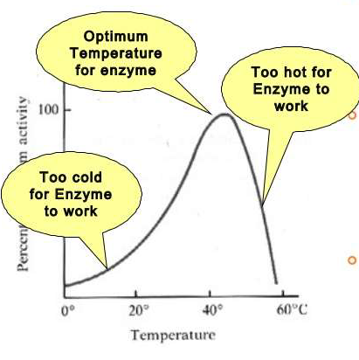

Slide 30
4-PH
Most enzymes are effective only within a relatively narrow PH range. Most body enzymes have optimal PH as that of the body ( 7.35 – 7.45 ).
Optimal PH: the PH at which the enzyme is most active.However, So enzymes have their activities below or above there PH values .
Pepsin : 1, Acid phosphatase: 4, alkaline phosphatase: 9

Slide 31
